Slide 1
n}lu+s lje]bdf cfwfl/t lx+;fsf] cj:yf
k'if @)&% b]lv h]7 @)&^ ;Dd
;+lhtf ltlD;gf
sfo{qmd ;+of]hs M dlxnf lx+;f lj?4sf] cleofg
cf]/]s

Slide 2
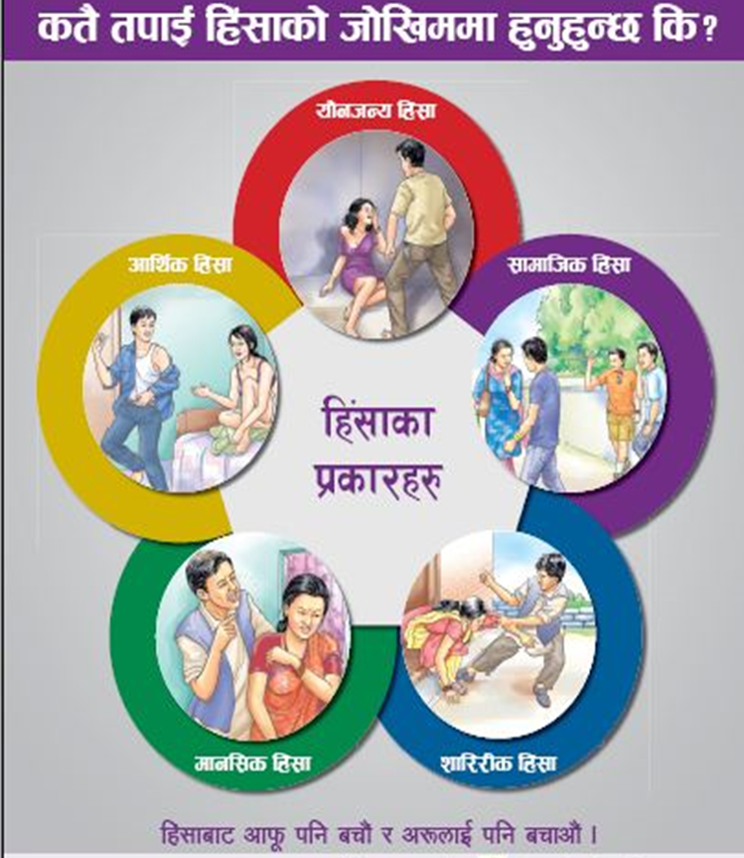
k[i7e'ld
dlxnfdflysf] lx+;f dlxnfx¿sf] dfgj clwsf/sf] uDeL/ pNn+3g xf] . dlxnfdfly x'g] lx+;fn] dlxnfsf] :jtGqtf, dof{lbt / ;dfhdf cfTd;Ddfg;lxt afFRg kfpg] clwsf/, ;dfgtfsf] clwsf/, oftgf / eod'Qm eO hLjg lhpg kfpg] clwsf/ h:tf cfwf/e"t clwsf/x¿ s'l07t u/]sf] 5 . 3/b]lv ;fj{hlgs / sfo{:yndf ;d]t al9/x]sf lx+;fsf 36gfsf tYofª\sn] dlxnfsf] zf/Ll/s, dfgl;s :jf:Yosf ;fy} cfTd;Ddfg, kl/jf/ / cGtt ;dfhdf k|ToIf c;/ kf/]sf] 5 eg], b]zsf] ljsf;, pTkfbg / / xfd|f ;Gtltx¿df ;d]t k|ToIf?kdf gsf/fTds k|efj kf/]sf] 5 .

Slide 3
cf]/]s g]kfndf clen]lvs/0f ePsf] M ^!&
;~rf/dfWoddf k|sflzt M @%$
hDdf M *&!

Slide 4
dlxnfdfly x'g] lx+;fsf] 36gfsf] k|sf/
dlxnfdfly x'g] lx+;fsf] 36gfsf] k|sf/
3/]n' lx+;f | 433
;fdflhs lx+;f | 102
anfTsf/ | 149
anfTsf/sf] k|of; | 28
xTof | 52
of}g b"Jo{jxf/ | 42
xTofsf] k|of; | 5
dfgj a]rlavg | 13
arlavgsf] k|of; | 3
cfTdxTof | 18
cGo | 26
hDdf | 871
k'if @)&% b]lv h]i7 @)&^ ;Dd

Slide 5
k|efljtsf] pd]/ ;d"x
k|efljtsf] pd]/ ;d"x
!^ aif{eGbf sd | 178
!& b]lv @% | 304
@^ b]lv #% | 224
#^ b]lv $% | 101
$^ b]lv %% | 24
%^ b]lv dfly | 16
yfxf gePsf] | 24
hDdf 871
k'if @)&% b]lv h]i7 @)&^ ;Dd

Slide 6
k|efljt tyf kL8slarsf] ;DaGw
k|efljt tyf kL8slarsf] ;DaGw
>Ldfg | 387
l5d]sL | 208
kl/jf/sf ;b:o | 127
k|]dL | 26
;fyL | 33
lzIfs | 25
ckl/lrt | 65
hDdf | 871
k'if @)&% b]lv h]i7 @)&^ ;Dd

Slide 7
kL8ssf] pd]/ ;d"x
kL8ssf] pd]/ ;d"x
!^ aif{eGbf sd | 23
!& b]lv @% | 159
@^ b]lv #% | 297
#^ b]lv $% | 127
$^ b]lv %% | 57
%^ b]lv dfly | 22
yfxf gePsf] | 186
hDdf | 871
k'if @)&% b]lv h]i7 @)&^ ;Dd

Slide 8
anfTsf/af6 k|efljtx? / kL8slarsf] ;DaGw
anfTsf/af6 k|efljtx? / kL8slarsf] ;DaGw
kl/jf/sf ;b:o | 23
>Ldfg\ | 5
l5d]sL | 75
;fyL | 11
k|]dL | 8
lzIfs | 5
;]jf k|bfos | 2
ckl/lrt | 20
hDdf | 149
k'if @)&% b]lv h]i7 @)&^ ;Dd

Slide 9
anfTsf/af6 k|efljtx? pd]/ ;d"x
anfTsf/af6 k|efljtx? pd]/ ;d"x
!@ jif{ d'lg | 32
!# b]lv !* jif{ | 62
!( b]lv @% jif{ | 13
@^ b]]lv #% jif{ | 15
#^ b]lv dfly | 27
 | 149
k'if @)&% b]lv h]i7 @)&^ ;Dd

Slide 10
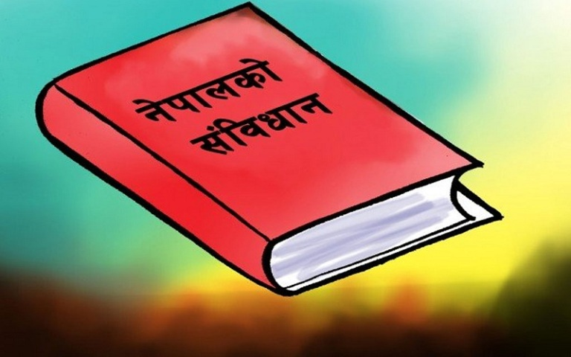
;+j}wfgLs Joj:yfx?
k|:tfjgf
juL{o, hftLo, If]qLo, eflifs, wfld{s, n}+lus lje]b / ;a} k|sf/sf hftLo 5'jf5"tsf] cGTo u/L cfly{s ;dfgtf, ;d[l4 / ;fdflhs Gofo ;'lglZrt ug{ ;dfg'kflts ;dfj]zL / ;xeflutfd"ns l;4fGtsf cfwf/df ;dtfd"ns ;dfhsf] lgdf{0f ug]{ ;+sNk g]kfnsf] ;+ljwfgn] u/]sf] 5 .

Slide 11

df}lns xs / st{Jo -efu–#_
;dfgtfsf] xs -wf/f !*_
-!_ ;a} gful/s sfg"gsf] b[li6df ;dfg x'g]5g\ . s;}nfO{ klg sfg"gsf] ;dfg ;+/If0faf6 jl~rt ul/g] 5}g .
-@_ ;fdfGo sfg"gsf] k|of]udf pTklQ, wd{, j0f{, hft, hflt, ln+u, zf/Ll/s cj:yf, ckf+utf, :jf:Yo l:ylt, j}jflxs l:ylt, uef{j:yf, cfly{s cj:yf, efiff jf If]q, j}rfl/s cf:yf jf o:t} cGo s'g} cfwf/df e]befj ul/g] 5}g .
-#_ /fHon] gful/sx¿sf aLr pTklQ, wd{, j0f{, hft, hflt, ln+u, cfly{s cj:yf, efiff, If]q, j}rfl/s cf:yf jf o:t} cGo s'g} cfwf/df e]befj ug]{ 5}g .
-$_ ;dfg sfdsf nflu n}+lus cfwf/df kfl/>lds tyf ;fdflhs ;'/Iffdf s'g} e]befj ul/g] 5}g .
-%_ k}t[s ;DklQdf n}+lus e]befj ljgf ;a} ;Gtfgsf] ;dfg xs x'g]5 .

Slide 12
Wff/f #*= dlxnfsf] xs M
-!_ k|To]s dlxnfnfO{ n}+lus e]befj ljgf ;dfg j+zLo xs x'g]5 .
-@_ k|To]s dlxnfnfO{ ;'/lIft dft[Tj / k|hgg :jf:Yo ;DaGwL xs x'g]5 .
-#_ dlxnf lj?å wfld{s, ;fdflhs, ;f+:s[lts k/Dk/f, k|rng jf cGo s'g} cfwf/df zf/Ll/s, dfgl;s, of}ghGo, dgf]j}1flgs jf cGo s'g} lsl;dsf] lx+;fhGo sfo{ jf zf]if0f ul/g] 5}g . To:tf] sfo{ sfg"g adf]lhd b08gLo x'g]5 / kLl8tnfO{ sfg"g adf]lhd Ifltk"lt{ kfpg] xs x'g]5 .
-$_ /fHosf ;a} lgsfodf dlxnfnfO{ ;dfg'kflts ;dfj]zL l;4fGtsf] cfwf/df ;xefuL x'g] xs x'g]5 .
-%_ dlxnfnfO{ lzIff, :jf:Yo, /f]huf/L / ;fdflhs ;'/Iffdf ;sf/fTds lje]bsf cfwf/df ljz]if cj;/ k|fKt ug]{ xs x'g]5 .
-^_ ;DklQ tyf kfl/jfl/s dfldnfdf bDktLsf] ;dfg xs x'g]5 .

Slide 13
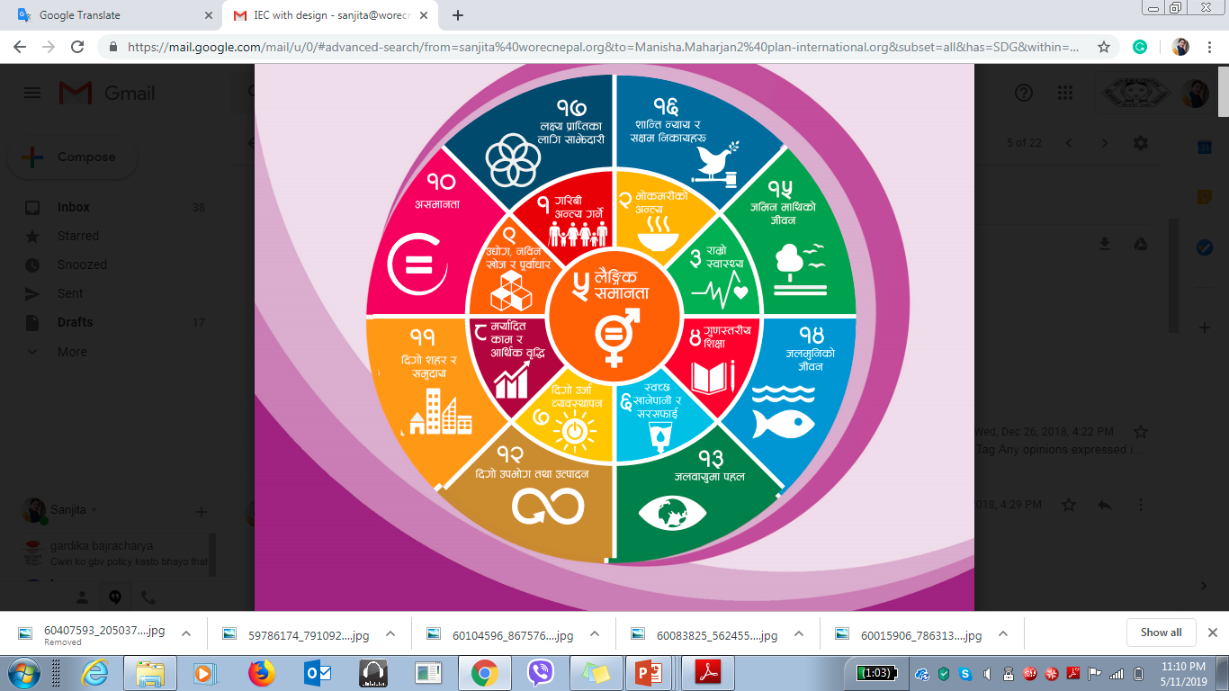

lbuf] ljsf; nIo
;g\ @)#) ;Dddf ;dfgtf, ;fdflhs GofonfO{ s]Gb|df /fVb} ;+;f/af6 ul/aL x6fpg] clek|fosf ;fy lbuf] ljsf; nIo tof/ u/L cfTd;fy ul/Psf] 5 . n}lu+s ;dfgtfnfO{ ljsf; / ;d[l4sf ;jfnsf ?kdf :yflkt gu/];Dd b]zdf lbuf] ljsf;, ;dfgtf, zflGt / ;d[l4sf] :yfkgf x'g] g;Sg] tYonfO{ ljZjn] cfTd;fy ul/;s]sf] 5 .

Slide 14

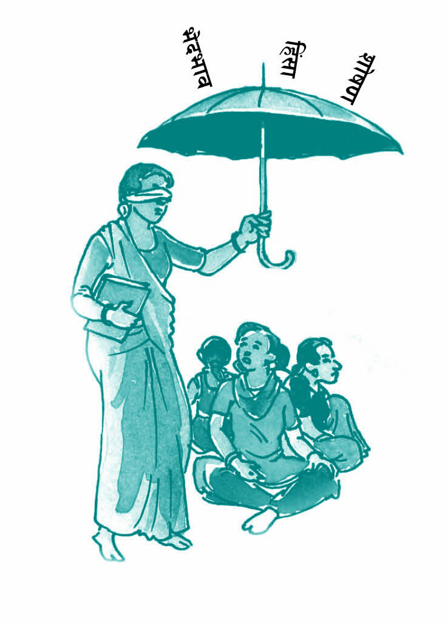
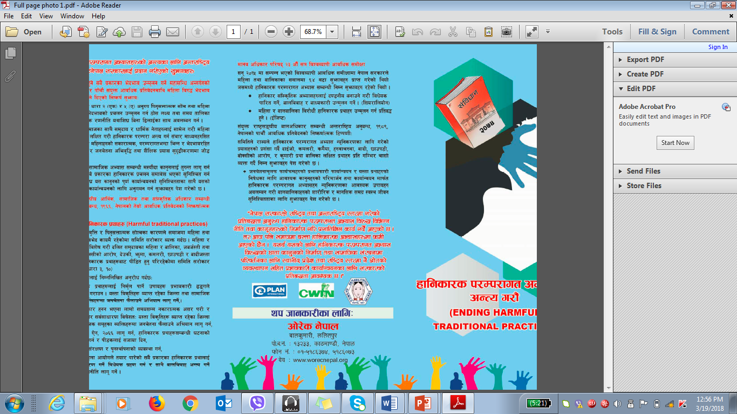
g]kfnsf] ;+ljwfg @)&@
g]kfnsf] ;+ljwfg @)&@ sf] wf/f #* sf] pkwf/f -#_ n] dlxnf lj?4 wfld{s, ;fdflhs,
;f+:s[lts k/Dk/f, k|rng jf cGo s'g} klg cfwf/df zf/Ll/s, dfgl;s, of}ghGo, dgf]j}1flgs jf cGo s'g} lsl;dsf] lx+;fhGo sfo{ jf zf]if0f ug{ gkfOg] s'/f k|i6?kdf pNn]v u/]sf] 5 .

Slide 15
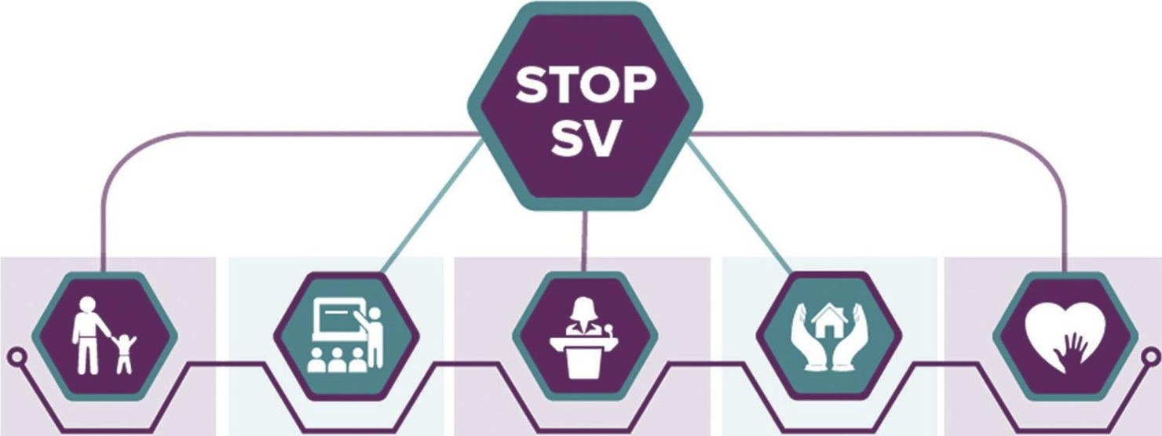
casf] af6f] ]
dlxnf tyf lszf]/L lj?4 lx+;f
lje]bsf/L ;fdflhs d"No dfGotf -xflgsf/s k/Dk/fut cEof;x?_ nfO{ kl/jt{g ug]{ vfnsf ultljlwx? ;+rfng ug]{ . | lx+;f /f]syfd ug{sf nflu cfGtl/s tyf cfly{s ;zlQms/0fsf sfo{qmd dfkm{t lbuf] hLljsf]kfh{gsf sfo{qmdx? ;~rfng ug'{kg{] . | dlxnf tyf lszf]/Lx?sf nflu ;j} If]qdf k|fyldstfsf ;fy cj;/ k|bfg ug]{ . | 3/, ;dfh tyf ;j} If]qdf ;'/lIft jftfj/0f lgdf{0f ug]{ | k|efljtx?sf nflu ;xof]uL ;+oGqx?sf] ;jnLs/0f / k|efljtsf] kx'Fr ;'lglZrt ug{] .

