Slide 1

An assessment on risk and preventive measures of Gender-Based Violence during lock-down period of COVID 19.
WOREC Nepal
June, 2020
Research Lead Team
Elawati KC- Program Coordinator
Narayan Sharma Ghimire- Grant and M&E Manager
Sabita Pokharel- Regional Program Coordinator
Sanjita Timsina- Senior Program Coordinator
Support provided by
Babu Ram Gautam, Lubha Raj Neupane, Laxmi Aryal and Entire WOREC Team

Slide 2
Statement of problem
The pandemic of COVID 19 has affected people of all regions, religions, races and genders. So far, the epidemic has affected 213 countries and territories worldwide. (https://www.worldometers.info/coronavirus/)
Like other disaster, COVID 19 has also mostly affected women and children.
Lockdown has been identified has an important way to prevent the spread of COVID 19 but it has had a serious social and economic impact, as well as a direct impact on the lives of women and girls.
Even before the COVID 19 infection, domestic violence was a major cause of human right violation of women.
During the time of this epidemic, such incidents have had multiple effects on women's overall health, especially sexual and reproductive health and mental health.
During the two-month period (from Chaitra 11, 2076 to Jestha 11, 2077), 604 incidents of gender-based violence were documented at the National Commission for Women and 465 at WOREC.
Incidents of domestic violence are under-reported even under normal circumstances. Due to the complex situation of women and girls who do not have access to the phone, access to the support agencies (police, service providers), reporting has become more inconvenient.

Slide 3
Objective of survey
To analyze the general perception of people on risk of gender-based violence (GBV) during lock down period of COVID 19;
To examine the availability, effectiveness, and challenges of services provided through support mechanisms established to address GBV;
To provide recommendation to ensure survivor's right to justice.
Methodology
Research design: Cross sectional
Sampling method: Convenient sampling
Sample size: 334 (including 149 Survivors)
Study population: GBV survivors, Police, representatives from One stop crisis management centre (OCMC), ward representatives, CBOs, management committee of safe house, bar association, judicial committee, human/women rights defenders, NGO/INGO.
Data collection method: Online survey on Google drive
Data collection period: 5th to 20th, May, 2020

Slide 4
Limitations
Unable to reach with those who are not access to internet.
As this is an online survey, there might be chance that respondent just give answer for the shake of filling questionnaire. Or, we can say that there is lack of two way communication.
For some online survey, our staff has facilatated to fill the questionnaire, at that time staff can be biased.

Slide 5

Findings

Slide 6
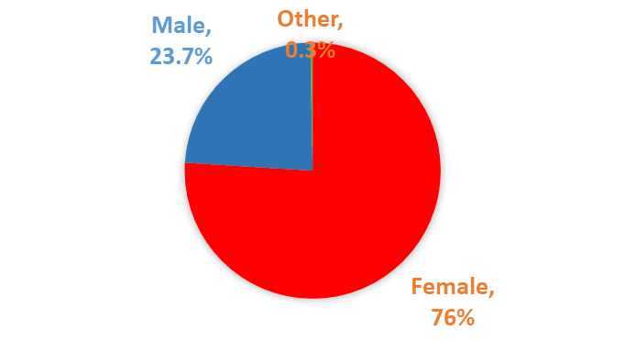
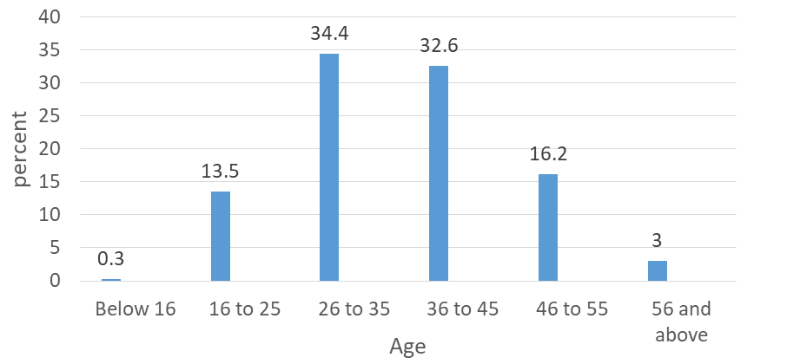
Socio-demographic information of respondents (N=334)
1. Caste
2. Gender
3. Age
4. Currently residing district (N=334)

Slide 7
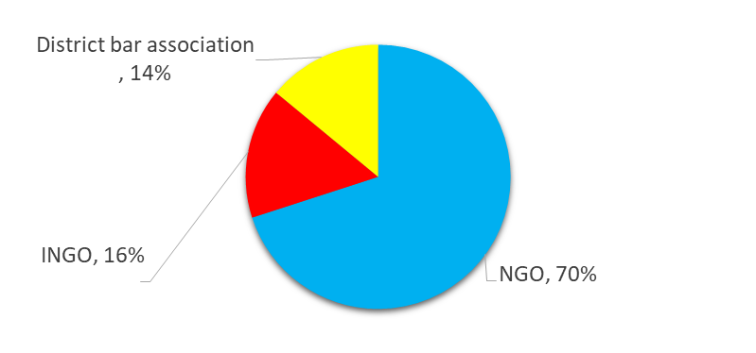
5. Classification of respondent (N-334)
Government service and local government representative, (N=53)
Non-Government service (N=57)

Slide 8
7. Survivor's marital status (N=149)
6. Survivor's engagement (N=149)

Slide 9

Findings related to topic

Slide 10
1. Chances of occurring violence during lockdown period
(N=334)
22%
56%
22%

Slide 11
2. Types of violence that can occur during lockdown period (N=334)
1. Domestic violence (multiple answer)

Slide 12
Contd..
2. Sexual violence (multiple answer)

Slide 13

3. Murder/attempt to murder /suicide/cyber crime(multiple answer)

Slide 14
3. Who do the survivor tell about the incident at first ?(N=334, multiple answer)
Notes:
Organization refers directly providing service....

Slide 15
4. How comfortable is it for a person affected by violence to lodge a complaint on violence against them? (N=334, multiple answer)

Slide 16
5. Challenges on lodging complaint (N=334)
23%
27%
20%
30%

Slide 17
6. What will make survivor easy to lodge complaint? (N=334, multiple answer)

Slide 18
7. Level of satisfaction with the government’s effort to prevent gender based violence? (N=334)

Slide 19
Level of satisfaction from different occupation
Characteristics | Govt service | Human right defenders, WHRD, activist | Member from mgmt cmt of safe house | Non-govt service | Rep from CBO | Survivor | Women rep from cooperative
Dissatisfied | 5.3% | 42.90% | 50% | 26.60% | 19.00% | 29.50% | 27.30%
Very dissatisfied | 0.00% | 3.60% | 0.00% | 6.30% | 0.00% | 3.40% | 0.00%
Satisfactory | 40.40% | 28.60% | 25% | 37.50% | 42.90% | 36.20% | 36.40%
Partially satisfied | 31.60% | 25.00% | 25.00% | 29.70% | 38.10% | 28.20% | 27.30%
Very satisfied | 22.80% | 0.00% | 0.00% | 0.00% | 0.00% | 2.70% | 9.10%

Slide 20
8. If you are not satisfied, why? (N=305, multiple answer)

Slide 21
9. Availability of GBV services (N=334)

Slide 22
10. Major constraints for not being able to provide regular services (N=334, multiple answer)

Slide 23
Conclusion
Majority of the respondents (56%) said there is high chance of occurring violence during lockdown period;
75% respondents said domestic violence like physical violence and verbal abuse can happen, 46% said rape, 36% said sexual abuse, 33% said attempt to rape and 49% said there is chance of happening suicide during lockdown period;
The survey said it would be difficult to lodge a complaint during the lockdown. 64.7% respondent said there is no situation to go out to lodge complaint, whereas 42.2% said it is difficult to lodge complaint from home.
Only 3% survivors are very satisfied with the government's effort to prevent gender based violence.
None of the human right activist/defenders, member from management committee of safe house, non-govrnmnt service, representative from CBOs are very satisfied with the government's effort to prevent gender based violence.
Twelve percent said services of gender-based violence were available, while 37 percent said services were provided but not regular.
57.5 percent said services were disrupted due to a lack of prior preparation and 57.2 percent said personal security supplies were not available. Similarly, 48.5 percent said that the service may have been disrupted due to lack of technical skills and knowledge on how to work in such a situation.

Slide 24
Recommendations
Establish the special response mechanism and preparedness for an effective response measuring the risk of violence against women and girls during any pandemic or disaster situation.
The Gender-based violence response mechanism should be included within essential services during a crisis situation.
Considering the effect of pandemic, an Inclusive awareness programs against GBV and information related to reporting mechanisms should be provided at the local level.
Hotline service should be available at every local level to immediately complaints by GBV survivors with provision to provide a response within 24 hours and refer to address the immediate needs of the survivors.
Judicial committees should continue the justice-related works in a safe manner.
Survivors centrist supportive mechanism should be strengthened and well equipped with necessary requirements such as PPE, isolated rooms.
Strengthen the government mechanism and infrastructures to be more responsive and inclusive to address the GBV.

Slide 25
There should be provision of counselors in every quarantine and counselors should be mobilized in high-affected areas. Similarly, considering the possibility of violence and vulnerability on women and girls, there should be separate quarantine spaces for them
Gender Equality policies should be developed in every local municipality to address the special need of women and gender and sexual minority groups. Additionally, the monitoring mechanism also should be developed to measure the progress of the local government to achieve gender equality.
Trained and skilled manpower should be prepared for quick response work at every local level.

Slide 26
Thank you.

